Slide 1

REVIEW – 1
CORNERSTONE PROJECT BASED LEARNING
Number System Toolkit
Object Oriented Programming through C++
II Year – 3rd Semester
TEAM MEMBERS
M. Vamsi Kalyan 25B11CS623
M. S. S. Srikar 25B11CSA88
1

Slide 2
Abstract
The Number System Toolkit is an interactive console-based application developed in C++ using Object-Oriented Programming concepts.
It supports two number systems, Binary, and Decimal, enabling conversions and Palindrome and Prime checking.
The design is based on a parent class NumberSystem with two derived classes, each implementing specific conversion and validation logic.
Key OOP concepts demonstrated include inheritance, polymorphism, encapsulation, and abstraction.
A menu-driven interface makes the application user-friendly and easy to navigate.
2

Slide 3
Problem Definition
Manual conversion between number systems is error-prone and time-consuming, especially for large values.
Students and professionals working in computing frequently need to convert between Binary and Decimal.
There is no simple, dedicated tool that handles two number systems together with arithmetic support.
The project proposes a C++ based application to automate number system conversions and basic arithmetic operations.
The application should also validate user input to prevent incorrect base entries.
3

Slide 4
Objectives
Develop a simple, menu-driven C++ application for number system conversions and basic operations.
Implement a base class NumberSystem and four derived classes using inheritance.
Support conversion between all four number systems: Binary, Decimal.
Validate user input to ensure the entered value is valid for the selected number base.
Perform Palindrome and Prime checking operations directly within each number system.
Apply OOP concepts — encapsulation, abstraction, inheritance, and polymorphism — in a practical context.
4

Slide 5
Scope of the Project
Number system selection by the user (Binary, Decimal).
Input validation to check whether the entered number is valid for the selected base.
Conversion between two number systems.
Prime and Palindrome checking for each Number system.
Display of results in a clear and formatted manner.
Future enhancement: support for floating point numbers and file-based history storage.
5

Slide 6
Planned Modules / Functions
Module 1 – NumberSystem Base Class
Module 2 – Binary Class
Module 3 – Decimal Class
Module 4 – Menu Interface
6

Slide 7
Inputs and Expected Outputs
Inputs:
User selects number system — Binary or Decimal.
User enters the number value as input.
User selects operation — Convert, Check Prime, or Check Palindrome.
Expected Outputs:
Binary → Decimal : converted decimal value displayed.
Decimal → Binary : converted binary value displayed.
Prime check : displays whether the number is prime or not.
Palindrome check : displays whether the number reads same forwards and backwards.
Validation error : error message displayed if input is invalid for the selected base.
7

Slide 8
Algorithm
Step 1 : Start the program and display the main menu.
Step 2 : User selects number system — Binary or Decimal.
Step 3 : Accept the number value from the user.
Step 4 : Validate input — if invalid, show error and go back to Step 3.
Step 5 : Display operation menu — Convert, Prime Check, or Palindrome Check.
Step 6 : If Convert — perform Binary↔Decimal conversion and display result.
Step 7 : If Prime Check — convert to decimal, check divisibility, display result.
Step 8 : If Palindrome — reverse value string, compare with original, display result.
Step 9 : Ask user to continue — if Yes go to Step 2, if No go to Step 10.
Step 10 : Stop the program.
8

Slide 9
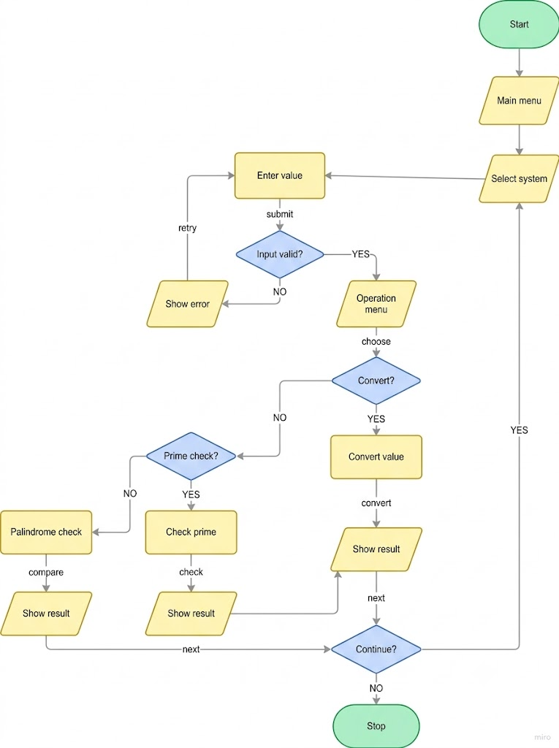
Flowchart
9

Slide 10
C++ / OOP Concepts
Class & Object — NumberSystem, BinarySystem, DecimalSystem are classes; objects are created inside main() based on user choice.
Encapsulation — value, base, decimal are stored as protected members — not directly accessible from outside the class.
Abstraction — validate(), convert(), and decimal_conversion() are declared as pure virtual functions — internal logic is hidden behind simple function calls.
Inheritance — BinarySystem and DecimalSystem inherit all common properties and functions from NumberSystem using public inheritance.
Polymorphism — decimal_conversion() is overridden differently in each derived class — Binary uses positional value method, Decimal uses place value method.
Virtual Functions — Pure virtual functions in base class force every derived class to provide their own implementation.
Constructor — Base class constructor initializes base and decimal; derived class constructors call parent constructor with their specific base value.
String Handling — value stored as string to handle leading zeros and character-level digit validation easily.
10

Slide 11
Team Member Contributions
M. Vamsi Kalyan (25B11CS623) – Project Lead: Problem analysis, class hierarchy design, and overall project development.
M. S. S. Srikar (25B11CSA88) – Development Support: Module planning, conversion logic research.
11

Slide 12
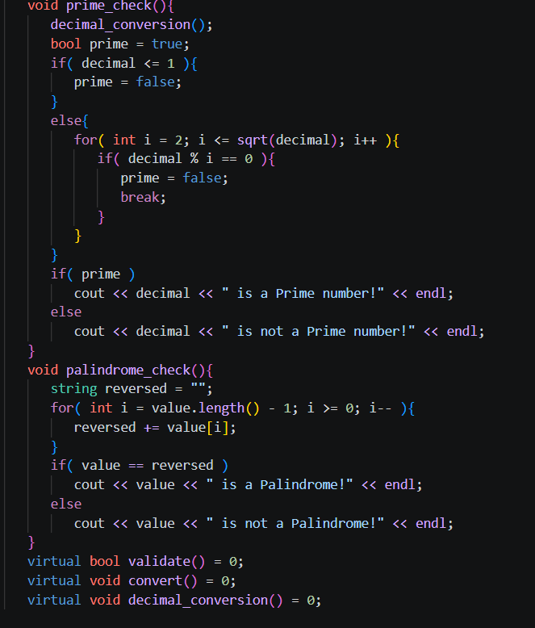
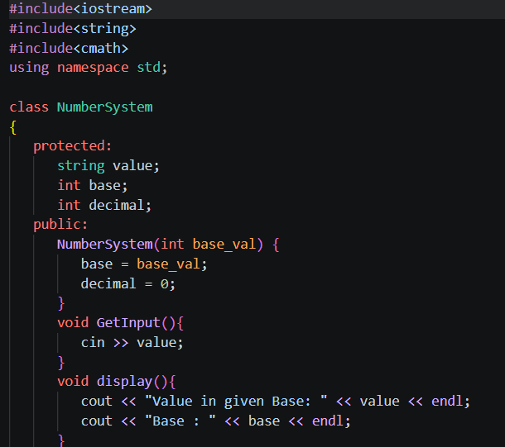
Implementation
Module 1 : NumberSystem (Base Class)
Acts as the blueprint for two number systems.
Uses encapsulation — value, base, decimal are protected, not accessible directly from outside.
“prime_check()” and “palindrome_check()” written once here and inherited by both derived classes — avoids code repetition.
“decimal_conversion()” declared as pure virtual — forces every derived class to write its own version.
“validate()” and “convert()” are also pure virtual, making “NumberSystem” an abstract class (cannot create object of it directly)
13

Slide 13
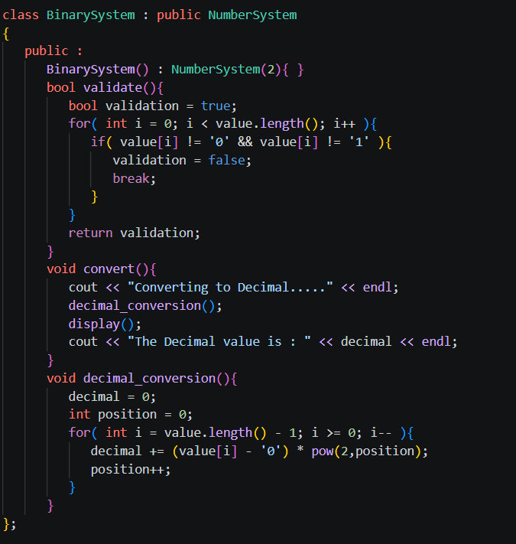
Implementation
Module 2 : Binary System
"BinarySystem : public NumberSystem" means BinarySystem inherits the properties and functions of NumberSystem.
The constructor is "BinarySystem() : NumberSystem(2)". Here, 2 is passed to the base class because the binary number system has base 2.
The "validate()" function checks whether the input contains only 0 and 1. If any other digit is present, it returns false.
The "decimal_conversion()" function converts binary to decimal. It starts from the rightmost digit, assigns positions starting from zero, and calculates each digit using powers of 2.
The "convert()" function calls the conversion function and displays the decimal result.
13

Slide 14
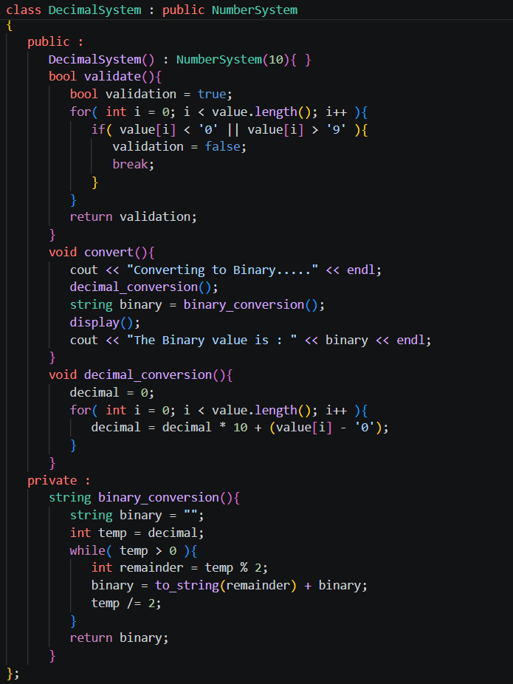
Implementation
Module 3 : Decimal System
Inherits all properties and functions from NumberSystem.
Sets base = 10 automatically through constructor.
“validate()” checks each character is between 0 and 9.
“decimal_conversion()” uses standard place value method, multiply running total by 10 and add digit.
“binary_conversion()” uses repeated division by 2 and remainders read bottom to top give binary result.
“convert()” directly converts to Binary, clean and straightforward.
13

Slide 15
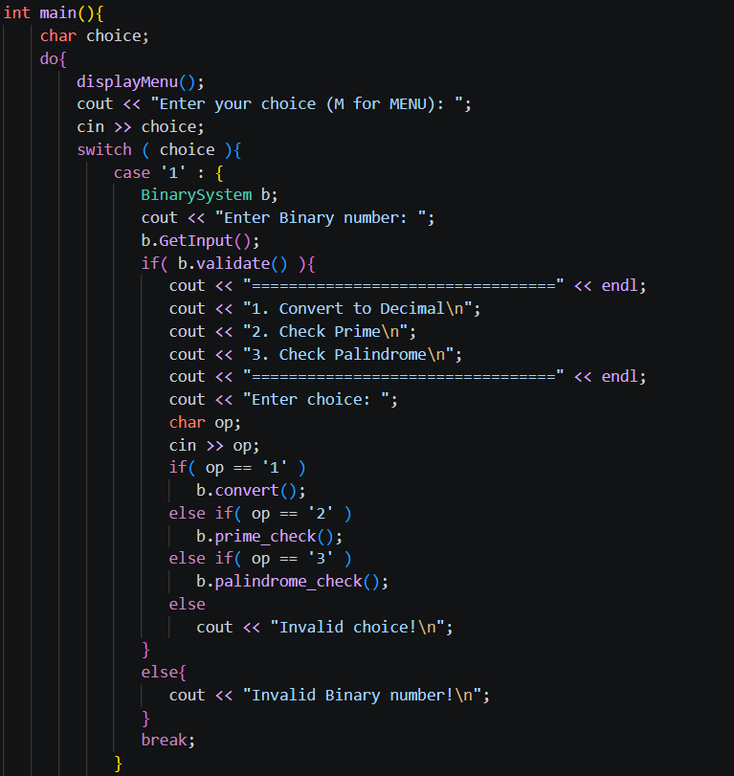
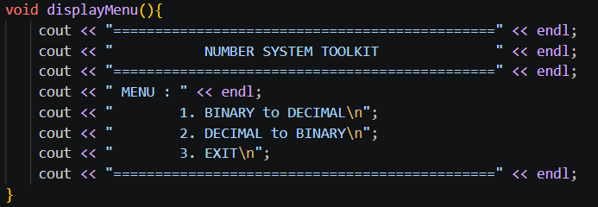
Implementation
Module 4 : Main Function
Acts as the controller, connects everything together.
Creates objects of BinarySystem or DecimalSystem based on user choice, demonstrates polymorphism.
do-while loop keeps program running until user exits, standard menu-driven design.
“case 1” : Creates a BinarySystem object and takes binary input from the user, then validates it before proceeding. If valid, shows a sub menu and calls convert(), prime_check(), or palindrome_check() based on user's choice.
13

Slide 16
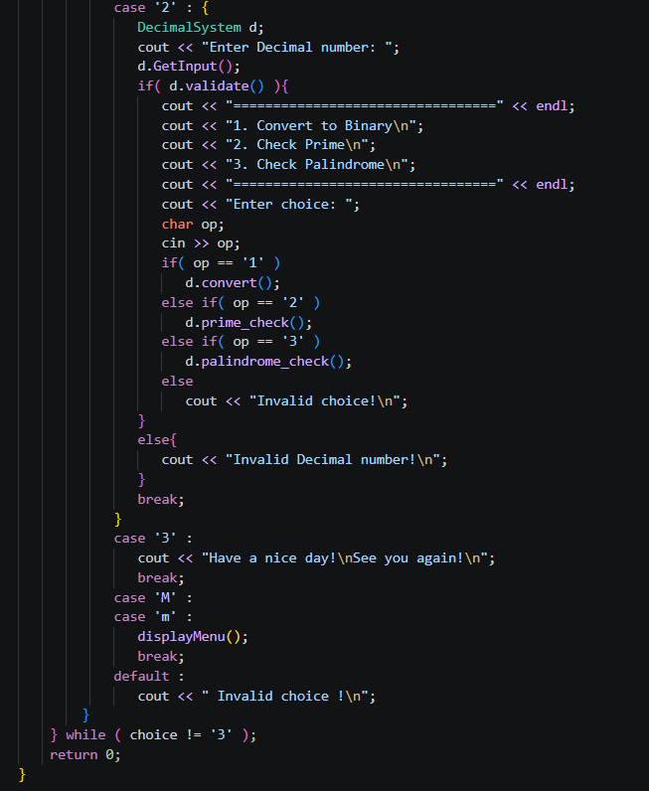
Implementation
“case 2” : Creates a DecimalSystem object and takes decimal input from the user, then validates it before proceeding. If valid, shows a sub menu and calls convert(), prime_check(), or palindrome_check() based on user's choice.
“case 3” : Prints a goodbye message and terminates the do-while loop by satisfying the exit condition choice != ‘3’.
case ‘M’ and case ‘m’ call displayMenu() to reprint the menu whenever the user forgets the options.
Any input that doesn’t match cases 1, 2, 3, M or m, prints “Invalid Choice!” and loops back. Therefore, program never crashes on wrong input.
13

Slide 17
Summary
Built a console-based Number System Toolkit in C++ using OOP concepts like inheritance, polymorphism, encapsulation and abstraction.
Designed an abstract base class NumberSystem with common properties value, base, decimal and common functions prime_check() and palindrome_check().
Created two derived classes — BinarySystem and DecimalSystem — each overriding validate(), convert() and decimal_conversion() with their own logic.
Implemented Binary to Decimal and Decimal to Binary conversions, prime checking and palindrome checking with proper input validation.
Built a menu-driven interface with a separate displayMenu() function and a do-while loop that keeps the program running until the user exits.
13

